Slide 1
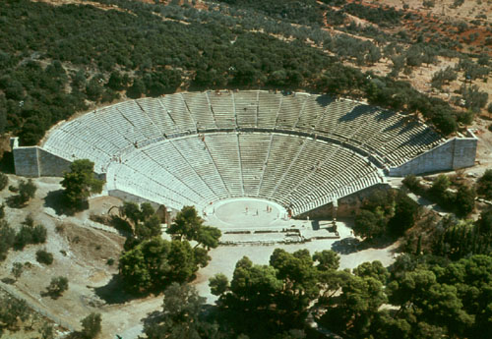
EPIDAURUS THEATRE

Slide 2
WHERE-WHEN
The theatre was built on the west side of mount Kynortio (in Argolida prefecture, north-east Peloponnese), at the end of the classical era, in 340-330 BC. Until the third century AD, it hosted music, song and drama competitions, as well as drama performances in the worship of Asclepius.

Slide 3
ASCLEPIUS
The god of medicine

Slide 4
The Designer
According to Pausanias, the theatre was designed by the architect Polykleitos the younger. This is disputed by several researchers. They believe that the creator is still unknown.

Slide 5
The construction
On the slope of the hill lies the limestone cavea/koilon, laterally supported by poros stone walls. It was built in two phases. Initially there was only the lower tier, with an 8,000 seat capacity, while the upper part, the epitheatro, was added in the mid-second century BC, increasing the theatre's capacity to 13,000-14,000 seats.

Slide 6
A paved diazoma (landing), 1.90m in width, separates the two parts of the cavea. The lower part contains 34 rows of seats, divided by 13 radiating stairways into 12 equal cunei, while the upper part contains 21 rows, and 12 more radiating stairways split each cuneus in two sections.

Slide 7
The first and the last row of the lower part, plus the first row of the epitheatro have backed seats. The cavea/koilon was surrounded by a corridor and a protective wall of poros stone, pierced by a central entrance.

Slide 8
Monumental two-door propyla (entrance doors) at the parodoi (passageways) led to the proscenium (front of scene) through an ascending ramp.

Slide 10
A wide corridor separates the cavea from the orchestra, which is a perfect circle 20m in diameter; at its centre stands the foundation of the Dionysus altar, the Thymeli.

Slide 11
Harmony-sound

Slide 12
THE THEATRE'S EXCELLENT HARMONY
is due to unique planning, based on a regular pentagon enclosing the orchestra, and the use of three middle points for the layout of the curved tiers, according to the cavea its particular egg-shaped form:

Slide 13
the first point is at the centre of the orchestra for the layout of the central tiers, and the other two equally distant from the first, for the layout of the side tiers (on the left and the right).
By this subterfuge, and others such as creating cavities at the base of seats, the architect improved the absorption and reverberation of sound waves.

Slide 15
PLAN

Slide 16
